Slide 1
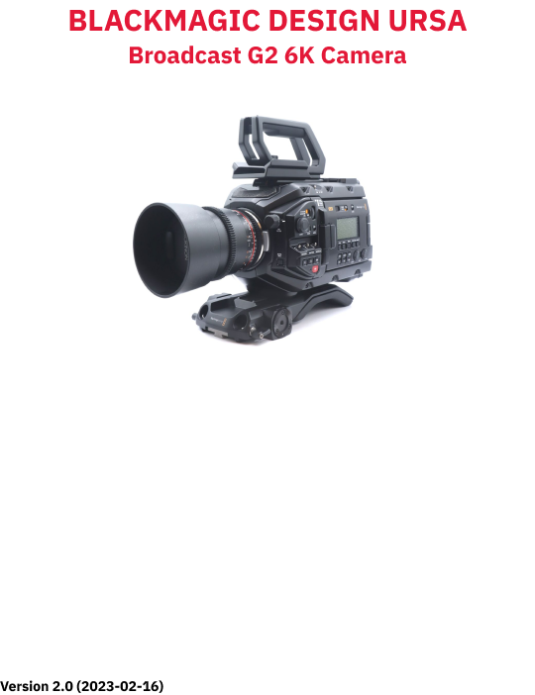

Slide 2
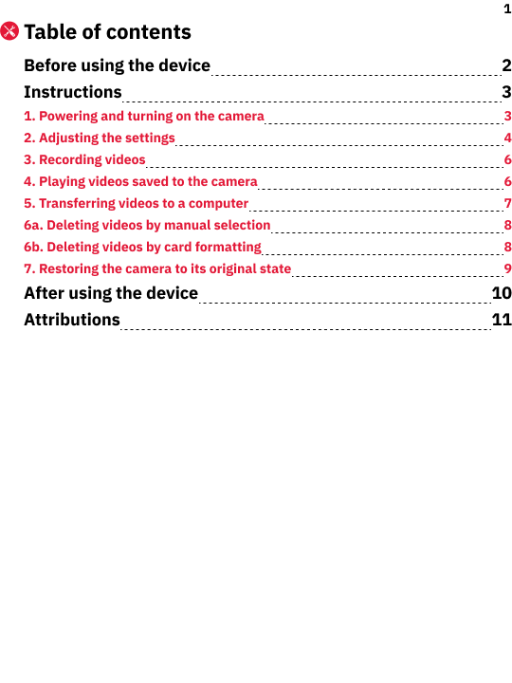

Slide 3
2
Before using the device
1.
Keep the lens away from sunlight and extreme temperatures.
2.
Clean the lens with a dry cloth and avoid using chemicals.
3.
Let staff know if you want to move the camera and tripod or remove the camera from the tripod for handheld use.
4.
Don’t use highly reflective objects, such as metals, in the scene that you record. Doing so might lead to improper white-balance adjustment.
5.
Before turning on the camera make sure you have the right lens attached as per your video requirements.
6.
Ensure that the dust cover is on the lenses when camera is not in use.

Slide 4
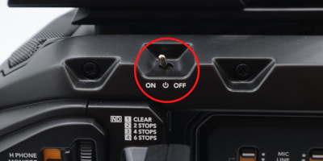
3
Instructions
1.
Powering and turning on the camera
1.
Decide whether you want the camera to be fixed at a recommended position, fixed at a different position, handheld:
1a.
If you want the camera to be fixed at any location, allow staff to remove its battery pack and connect its DC power cable.
1b.
If you want the camera to be handheld, allow staff to insert its battery pack and disconnect its DC power cable.
2.
Remove the lens cap from the lens:
2.1.
Pinch and hold the cap’s two side-releases.
2.2.
Pull the cap away from the lens.
3.
Open/unfold the touchscreen display panel on the left side of the camera.
4.
Push the On/Off switch, also on the left side, to the On position (Fig. 2a). After several seconds, the display will show imagery from the lens.
Fig. 1a. On/Off switch
5.
Ensure that the display shows the subject/object to be recorded.

Slide 5
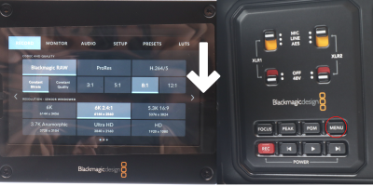
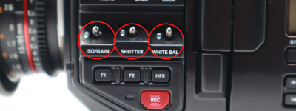
4
2.
Adjusting the settings
1.
Press the Menu button in the controls area of the camera body (Fig. 2a) or swipe downward on the display. The “Record” menu will appear.
Fig. 2a. “Record” menu on display (left) and Menu button in controls area (right)
2.
In the “Codec And Quality” section, select “H.264/5.”
3.
(Recommended) Below the “H.264/5” option, select “High” (not “SDI”).
4.
Below the “Blackmagic RAW” option, select either “H.264” or “H.265.” In the “Resolution - Sensor Windowed” section (lower half of screen), your selection will highlight “HD” or “Ultra HD,” respectively.
5.
Press the Menu button to exit the “Record” menu. The main screen (recording interface) will appear on the display.
6.
Use the ISO/Gain switch on the left side of the camera toward its front (Fig. 2b) to change the brightness intensity of the display image.
7.
Use the Shutter switch (Fig. 2b) to set the shutter speed to “1/60” (30 frames per sec). The top-left of the interface shows the “Shutter” value.
8.
Use the White Balance switch (Fig. 2b) to change the colour temperature of the recorded content.
Fig. 2b. ISO/Gain, Shutter, White Bal switches

Slide 6
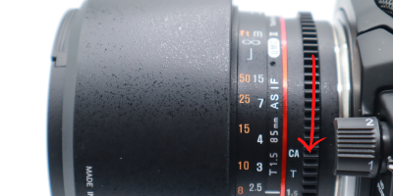
5
Note: The following steps refer to the Rokinon 85 mm lens.
9.
(Optional) Turn the smaller (inner) ribbed dial on the lens (Fig. 2c) to adjust its aperture (size of lens opening). Adjusting the aperture affects how much of the frame is in focus, as well as the brightness of the frame.
Fig. 2c. Manual adjustment to lens aperture using smaller dial on lens
10.
(Optional) Turn the larger (outer) ribbed dial on the lens to adjust its sharpness.

Slide 7
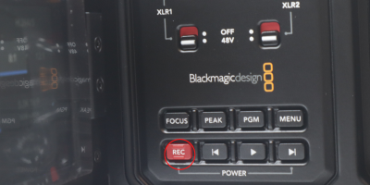
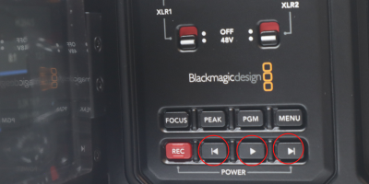
6
3.
Recording videos
1.
Locate the SD/CFAST switch (top-right part of controls area) and slide it to the SD setting.
2.
Select an SD card for recording by tapping one of the options on the the default screen (bottom of interface).
3.
Start recording by either pressing the Rec button in the controls area (Fig. 3a) or the record icon (red circle) at the bottom of the display.
4.
Stop recording by pressing the Rec button or the record icon.
Fig. 3a. Rec button in controls area
4.
Playing videos saved to the camera
1.
Click the play button (right-facing triangle) in the controls area (Fig. 4a) to view recorded content.
2.
Switch between clips using the reverse-skip button or the forward-skip button in the controls area (Fig 4.a). The playback screen has similar icons.
Fig. 4a. Reverse-skip (left), play, and forward-skip (right) buttons in controls area

Slide 8
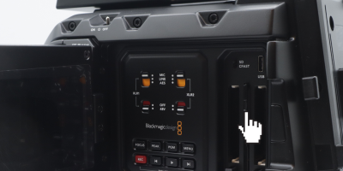
7
5.
Transferring videos to a computer
1.
Turn off the camera:
1.1.
Slide the On/Off switch to the Off position. Wait several seconds.
1.2.
Check the LED display on the front of the display panel (or the indicator light next the Rec button near the front) to ensure that the camera is off.
2.
Remove the SD card to which you recorded video(s) (Fig. 5a):
2.1.
Press the exposed edge the card. It will click and extend outward from the slot.
2.2.
Grab and remove the SD card.
Fig. 5a. Location and removal of the SD Card
3.
Insert the SD card into the computer’s SD card slot.
4.
Open the virtual container (folder) that represents the SD card:
4.1.
Open either a File Explorer window (Windows/PC) or a Finder window (macOS/Mac).
4.2.
Open (click) the SD card’s container in the window sidebar.
5.
Copy your video(s) to your physical storage device(s) and/or cloud storage account(s).

Slide 9
8
6a.
Deleting videos by manual selection
1.
Delete any copies that you’ve saved to the MCL workstation computer.
2a.
(PC/Windows) Delete the original video(s) from the camera’s SD card:
a1.
In a File Explorer window, navigate to the SD card.
a2.
Select your video(s).
a3.
Right-click on the video(s) and select the “Delete” command.
a4.
At the “Delete File” prompt, click “Yes.”
2b.
(Mac/macOS) Delete the original video(s) from the camera’s SD card:
b1.
In a Finder window, navigate to the the SD card.
b2.
Select your video(s).
b3.
Right-click on the video(s) and select the “Move to Trash” command.
6b.
Deleting videos by card formatting
Formatting/erasing the SD card can be more efficient if you have many videos, especially if they’re in multiple folders.
1a.
(PC/Windows) Use the Format command to completely erase the SD card:
a1.
In a File Explorer window, right-click on the SD card container in the sidebar. A command window opens.
a2.
Select the “Format...” command. A window appears with the title, “Format [SD card’s name].”
a3.
In the “File system” dropdown menu, select “exFAT (Default).” This format is compatible with Windows and macOS computers.
a4.
Click the “Start” button. A confirmation prompt appears.
a5.
Click the “OK” button.
1b.
(Mac/macOS) Use the Disk Utility app to completely erase the SD card:
b1.
Click the Spotlight search (icon of magnifying glass) in the top-right corner of the menu bar.
b2.
Type “Disk Utility” in the text field. Search results will appear below it.
b3.
Open the “Disk Utility” app from the search results.
b4.
In the app sidebar, select the SD card.
b5.
In the app toolbar, select the “Erase” command. A window will appear.
b6.
In the “Format” dropdown menu, select “ExFAT.” This format is compatible with Windows and macOS computers.
b7.
Click the “Erase” button. A window will show the progress.
b8.
Close the “Disk Utility” app.

Slide 10
9
2a.
(PC/Windows) Safely remove the SD card from the computer:
a1.
Open a File Explorer window and right-click on the SD card’s container in the window sidebar. A command window pops opens.
a2.
Select the “Eject” command. The SD card will disappear from the window sidebar.
a3.
Physically remove the SD card (or adapter) from the computer.
2b.
(Mac/macOS) Safely remove the SD card from the computer:
b1.
Open a Finder and right-click on the SD card’s container in the window sidebar. A command window pops opens.
b2.
Select the “Eject [SD card name]” command. The SD card will disappear from the window sidebar.
b3.
Physically remove the SD card (or adapter) from the computer.
7.
Restoring the camera to its original state
1.
Re-insert the SD card into the camera:
1.1.
Insert the SD card into its slot in the camera’s controls area.
1.2.
Press the exposed (top) edge of the SD card until that edge is flush with the slot opening.
2.
Push in/close the camera’s display panel.
3.
Re-attach the lens cap onto the lens:
3.1.
Pinch and hold the cap’s two side-releases.
3.2.
Press the cap into/against the housing of the lens.
3.3.
Release the cap’s side-releases.
4.
If the camera is detached from its tripod, place it on a desk and notify staff.

Slide 11
10
After using the device
1.
Return the camera to its original position in the studio, if applicable. Ask staff for help, if needed.

Slide 12
11
Attributions
1.
Contributors
Media Creation Lab / York University Digital Scholarship Infrastructure
Maykel Faragalla, photographer
Tim Huynh, editor & co-lead writer
Rafia Naz, co-lead writer
Shawon Saha, co-lead writer
BonaFide Communications, York University Writing Department
Nicole Bednarski, consultant
Charlotte MacDowell, consultant
Sophie Morgan, consultant
Amanda Naoum, consultant
Lorena Urican, consultant
Patrons of the Media Creation Lab
This work is licensed under a Creative Commons Attribution-NonCommercial 4.0 International License.

