Slide 1
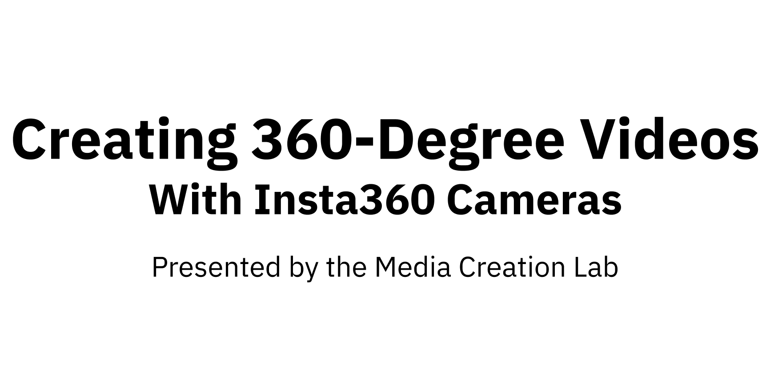
1

Slide 2
Contents
MCL
2
1.
Core Concepts
3
2.
Insta360 One R: Hardware
9
3.
Insta360 One R: Software
17
4.
Insta360 Studio: Editing
28
5.
Publishing
42
References
44

Slide 3
1. Core Concepts
MCL
3

Slide 4
1.1. Core Concepts: Form
MCL
4
Lenses (2+) facing different direction
Blind spots
Built-in software stitches imagery together
Other functions: Stabilization, object removal

Slide 5
1.2. Core Concepts: Function
MCL
5
Spaces
Entire physical environments
Scenes
Entire group of activities/subjects
Scenarios
Places of pertinent possibility

Slide 6
1.3. Core Concepts: Discretion
MCL
6
Intended communication?
Mona Lisa vs Mona Lisa in the Salle Des États
Safety/security?
Mobile vs stationary
Informed consent?
Public settings
Duration?
One R battery: ~45 min at highest settings

Slide 7
1.4. Core Concepts: Photography
MCL
7
Three settings affect exposure to light:
Aperture (F-Stop): Size of lens opening
Pupil of eye
Shutter speed: Time of lens exposure
Blink of eyelid
ISO
Exposure value (EV): Aperture & shutter speed
Use Automatic settings or research Manual settings

Slide 8
1.5a. Core Concepts: Manual Settings
MCL
8
Suggested base-settings for outdoor environments:
Color
Shutter speed
ISO
White Balance
Sunny
Vivid
1/200
100 - 400
5500K
Cloudy
Standard 1/60 - 1/200 400 - 800 6000k - 7000k
(Wilkerson, n.d.; Rossi, 2023)

Slide 9
1.5b. Core Concepts: Manual Settings
MCL
9
Suggested base-settings for indoor environments:
Color
Shutter speed
ISO
White Balance
Bright
Vivid
1/50 (tripod)
1/60 - 1/200
800
2800K
Dim/Shaded
Standard 1/50 (tripod) 1/60 - 1/200 1600+
7500K
(Wilkerson, n.d.; Rossi, 2023)

Slide 10
1.6. Core Concepts: Basic Tips
MCL
10
Seek uniform lighting to mask stitching
Wipe lenses with microfibre cloth
Identify blind spots where stitching can be obvious
Aim main lens at main element in scene
Suppress BG noise: Settings -> Wind Noise Reduction

Slide 11
2. Insta360 One R: Hardware
MCL
11

Slide 12
2.1. One R Hardware: Overview
MCL
12
Modular system
Battery base
Core module (touchscreen, buttons, ports)
Lens module: dual-lens, wide-angle, or 1-inch
Image recording
Photos, videos, webcam
Image effects
Bullet Time, Time Lapse, Tiny Planet

Slide 13
2.2. One R Hardware: Core Module
MCL
13
Touchscreen
Top buttons
Power button (smaller, I/O icon)
Shutter button (larger, red circle icon)
Side openings (behind cover)
MicroSD card (file storage)
USB-C cable (charging, file transfer, input)

Slide 14
2.3. One R Hardware: Dual-Lens Mod
MCL
14
Front and back lenses
Back lens: Beside touchscreen
Field of view: Less than 180 degrees
Blind spots: Sides, top, & bottom of module

Slide 15
2.4. One R Hardware: Battery Base
MCL
15
Notch inserts (top)
Pair with notches underneath connected core & lens
Slide lock
Hold to remove battery
Visible yellow: Improper/loose connection
Battery life
Max resolution/framerate: ~45 min
Drains while turned off: Remove while storing

Slide 16
2.5. One R Hardware: Mount Bracket
MCL
16
Open bracket:
Locate slide-lock on buckle (top)
Push slide-lock (direction of arrow) & hold
Lift bottom-edge of buckle (Point to Track side)
Lift top-edge of buckle
Open ramp at back of bracket
Insert/remove camera through back of bracket

Slide 17
(continued)
MCL
17
Close bracket:
Insert/remove camera through back of bracket
Close ramp at back of bracket
Hook back-edge of buckle onto top-edge of ramp
Press (snap) front-edge of buckle onto top of bracket

Slide 18
2.6. One R Hardware: Selfie Stick
MCL
18
(Optional) Connect to tripod:
Screw top (or side) of tripod into Selfie Stick (bottom)
Screw Selfie Stick (top) into bracket hinge (bottom)
(Optional) Grab neck (ribbed top) of Selfie Stick & pull
Software removes Selfie Stick from underside blind spot

Slide 19
2.7. One R Hardware: Tripod
MCL
19
(Optional) Connect to Selfie Stick or camera (bracket)
Screw top (or side) of tripod into Selfie Stick or bracket
Hold (folded) tripod legs
Hold section (top) housing screws
Twist ribbed ring-lock until tight

Slide 20
3. Insta360 One R: Software
MCL
20

Slide 21
3.1. One R Software: Touchscreen
MCL
21
Long-press power button (smaller button on top)
Swipe touchscreen to view option screens
System settings: Downward (from top)
Media Gallery: Upward (from bottom)
Recording modes: Rightward (from left)
Recording parameters: Leftward (from right)
(Alternative) Select mode/parameters from main screen

Slide 22
3.2. One R Software: Recording
MCL
22
Select recording mode
(Optional) Change camera parameters*
(Optional) Change resolution/frame-rate
Long-press shutter button (top) to record
(Video) Long-press shutter button to stop
*Consider settings listed in Section 1.5 (8-9)

Slide 23
3.3. One R Software: Serial Number
MCL
23
Get serial number of camera:
(Main screen) Swipe downward
(System screen) Swipe rightward to page 2
Select Settings (gear icon)
Scroll to end of Settings screen & select Camera Info
Note serial number (SN)

Slide 24
3.4. One R Software: Mobile Device
MCL
24
Set up mobile device:
Enable Wi-Fi
Enable Bluetooth
Download Insta360 app (App Store or Google Play)
Install app
Note: Mobile app mirrors camera

Slide 25
3.5. One R Software: Mobile App
MCL
25
Pair mobile app/device & camera:
Open Insta30 app
Grant necessary permissions
Select Go to App button
Select Connect button (or camera icon in toolbar)
Turn on camera
(Camera) Select Confirm connection
Select Join for camera to join app network

Slide 26
3.6. One R Software: Recording (App)
MCL
26
Select camera icon (toolbar)
(Optional) Select mode (bottom of UI)
(Optional) Select parameters* (next to Record button)
Press Record button (circle icon)
(Video) Press Record button to stop
*Consider settings listed in Section 1.5 (8-9)

Slide 27
3.7. One R Software: View (App)
MCL
27
(If applicable) Exit recording screen
Select Album from toolbar
Select recording (photo/video)
(Optional) Select Export button

Slide 28
4. Insta360 Studio: Editing
MCL
28

Slide 29
4.1. Editing: Insta360 Studio Overview
MCL
29
Proprietary software (free)
https://www.insta360.com/download/insta360-oner
Download page requires serial number
Follow steps in section 3.3
Enter IAEAH14BRWSRX9
Includes plugins for third-party software
Adobe Premiere, Final Cut Pro

Slide 30
4.2a. Editing: File Transfer (USB)
MCL
30
Select Settings (gear icon) -> General -> USB Mode
Select U-Disk Mode
Open side cover of core module
Use USB cable to connect camera & computer
Turn on camera
Locate camera as disk drive on computer
Navigate to DCIM -> Camera01
Copy files to computer

Slide 31
4.2b. Editing: File Transfer (MicroSD)
MCL
31
Turn off camera (long-press power button)
Open side cover of core module
Press exposed edge of MicroSD card & remove
Insert MicroSD card into SD card adapter
Insert card adapter into computer
Locate camera as disk drive on computer
Navigate to DCIM -> Camera01
Copy files to computer

Slide 32
4.3. Editing: Studio UI
MCL
32
Menu bar
Essential actions/commands
Left panel: Files
Importing/imported files & rendering files (export)
Middle panel: Playback/editing
Image area, frame parameters & actions
Toolbars, timeline, export button
Right panel: Parameters/projects/properties

Slide 33
4.4. Editing: Studio Timeline
MCL
33
Playhead: Large, white line
Click timeline to set
Skimmer: Thin, yellow line
Move cursor along timeline
Trim start/end: Shorter, white lines
Mark start/end of exported project
Drag to spot or click Mark [...] start/end (at playhead)

Slide 34
4.5. Editing: Playback Shortcuts
MCL
34
Play/pause/resume: Space
Skip to trim-start: [
Skip to trim-end: ]
Zoom out timeline: Ctrl/Cmd + Minus key (-)
Zoom in timeline: Ctrl/Cmd + Equals key (=)
Forward/backward 1 frame: Right/Left
Forward/backward 10 frames: Shift + Right/Left
Increase/decrease volume: Up/Down

Slide 35
4.6. Editing: Playhead Shortcuts
MCL
35
Add trim start: Ctrl/Cmd + [
Add trim end: Ctrl/Cmd + ]
Add keyframe (Reframe View only): Ctrl/Cmd + K
Set parameters (FOV, angles, etc) at specific point

Slide 36
4.7. Editing: Image Area (360 Video)
MCL
36
Reframe View or 360 View (tabs above image)
Changing shown-image:
Click & drag: Change angle
Mouse-scroll up: Zoom out
Mouse-scroll down: Zoom in
What you see is what you get with Export reframed video

Slide 37
4.8. Editing: Image Toolbar
MCL
37
Lower-right corner of image area
(Reframe View) Ratio: Change aspect-ratio
Default: 16:9
(360 View) Switch FOV: Change field-of-view
Default: Fisheye
Take Snapshot: Ctrl/Cmd + S
Full Screen: Shift + Ctrl/Cmd + F

Slide 38
4.9. Editing: Editing Toolbar
MCL
38
Between image area & timeline, right-side
(Reframe View) Mark as keyframe: Mark transition
(Reframe View) Deep Track: Focus on subject
Follow prompts
Time Shift: Slow down or speed up
Starts at playhead, ends at click on timeline
Motion Blur: Toggle on/off motion blur

Slide 39
4.10. Editing: Keyframe Parameters
MCL
39
Views
Default (fisheye), Crystal Ball, Tiny Planet, Natural
Angles
Pan: x-axis (horizontal)
Tilt: y-axis (vertical)
Roll: z-axis (canted)
Field of view (FOV)
Distortion

Slide 40
4.11. Editing: Right Panel
MCL
40
Stabilization Type
Stitching: Presets & customization
Media Processing: Effects/filters for colour & audio
Logo Settings: Watermark image
Project Management:
Projects: Sets of changes auto-saved to source files
File Properties: Specifications of source file

Slide 41
4.12. Editing: Exporting Videos
MCL
41
Click Start Export button (yellow square, beside timeline)
Select export type:
Export reframed video: 2D video
Export 360 video: 360-degree video in suitable apps
(Optional) Adjust parameters
Set name & location

Slide 42
5. Publishing
MCL
42

Slide 43
5.1. Publishing
MCL
43
Video-hosting platforms:
Facebook
VeeR
Vimeo
YouTube

Slide 44
References
MCL
44

Slide 45
References
MCL
45
Rossi, T. (2023). Camera settings for portraits: Checklist for indoor & outdoor photoshoots. Fixthephoto. https://fixthephoto.com/camera-settings-for-portraits.html
Wilkerson, S. (n.d.). Color by Kelvin: A better approach to white balance. Click Community. https://www.theclickcommunity.com/blog/color-by-kelvin-a-better-approach-to-white-balance/

Slide 46
Attribution
MCL
46
Content by Tim Huynh
This work is licensed under a
Creative Commons Attribution-NonCommercial 4.0 International License.

