Slide 1
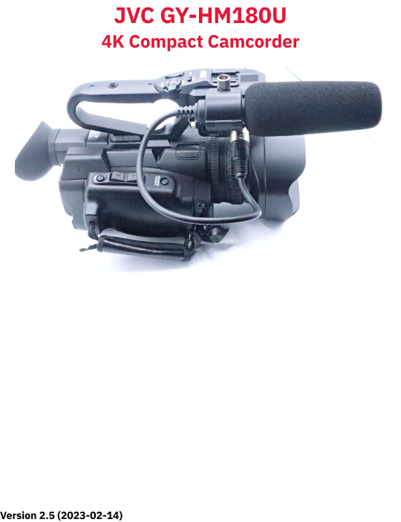

Slide 2
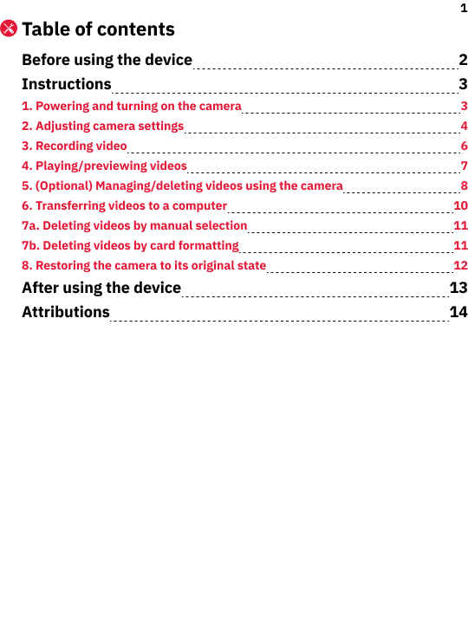

Slide 3
2
Before using the device
1.
Keep the lens away from sunlight and extreme temperatures.
2.
Clean the lens with a dry cloth and avoid using chemicals.
3.
Notify staff if you want to move the camera and tripod or remove the camera from the tripod.
4.
Don’t use highly reflective objects, such as metals, in the scene that you record. Doing so might lead to improper white-balance adjustment.

Slide 4
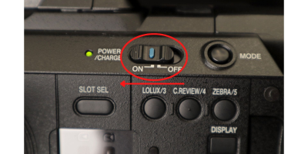
3
Instructions
1.
Powering and turning on the camera
1.
Decide whether you want the camera to be fixed at a recommended position, fixed at a different position, handheld:
1a.
If you want the camera to be fixed at any location, allow staff to remove its battery pack and connect its DC power cable.
1b.
If you want the camera to be handheld, allow staff to insert its battery pack and disconnect its DC power cable.
2.
Remove the lens cap from the lens:
2.1.
Pinch and hold the cap’s two side-releases.
2.2.
Pull the cap away from the lens.
3.
Pull out/open the display panel on the left side of the camera.
4.
Push down the On/Off switch, which is on the left side of the camera body.
5.
While pushing down this switch, slide it toward On (Fig. 1a). The camera will turn on and the Power/Charge indicator will light up. The display will show imagery after about 10 seconds.
Fig. 1a. Turning on power

Slide 5
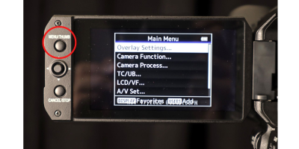
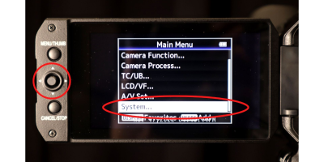
4
2.
Adjusting camera settings
1.
Adjust the recording format and/or mode:
1.1.
Press the Menu/Thumb button on the left side of the display panel. The Main Menu will appear on the display (Fig. 2a).
Fig. 2a. Main/Thumb button
1.2.
Use the four-way directional button (Fig. 2b) to highlight “System...”
1.3.
Press the directional button inward to select “System...”.
Fig. 2b. Four-way directional button and “System” option
1.4.
In the “System...” menu, select “Record Set…”
1.5.
(Optional) In the “Record Set…” menu, select “Record Format...” to change properties like file type, resolution, and frame rate.

Slide 6
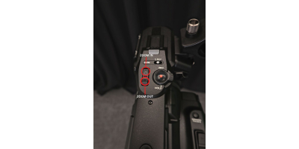
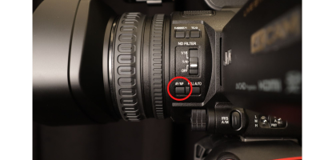
5
1.6.
(Optional) In the “Record Set…” menu, select “Rec Mode” to choose among types of recording modes like “Normal” (recommended) and “Pre Rec.”
1.7.
Press the Menu/Thumb button to close the current menu. The main/recording screen will re-appear.
2.
Use the T and W buttons on the right side of the camera (or on its handle) to zoom in and zoom out, respectively (Fig. 2c).
Fig. 2c. T and W buttons (on handle) control zoom direction/amount
3.
Select auto-focus by pressing the AF/MF toggle button on the left side of the camera (between the lens and display panel, Fig. 2d).
Note: While using manual-focus, the right side of the display shows an “MF” indicator. Auto-focus doesn’t have an indicator.
Fig. 2d. AF/MF button to toggle between focus modes

Slide 7
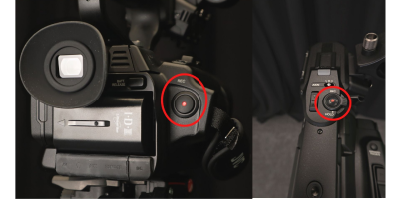
6
3.
Recording video
1.
Select the SD card to which you want to record:
1.1.
Locate the Slot Sel button in the controls area (left side of camera body with display panel open/unfolded).
1.2.
Press the Slot Sel button to toggle between inserted SD cards. The corresponding light (below the card) will indicate which one is selected (A or B).
2.
Start recording by pressing the Rec button on either the right/back side of the camera or on top of its handle (Fig. 3a). The display shows a red “Rec” (Recording) indicator in the top-centre position.
3.
Stop recording by pressing the Rec button. The display flashes a red “Stby” (Standby) indicator for 2 seconds in the top-centre position. Then “Stby” becomes a non-flashing white indicator.
Fig. 3a. Rec button on camera’s back/right side and on handle

Slide 8
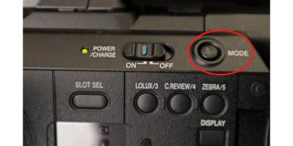
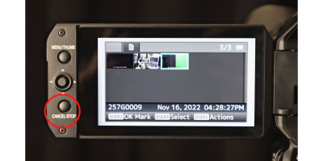
7
4.
Playing/previewing videos
1.
Press and hold the Mode button (left side body, Fig. 4a) for 2 seconds to open the gallery.
Fig. 4a. Mode button
2.
Move the directional button (display panel) to highlight a video.
3.
Press the directional button inward to play/preview the video.
4.
(Optional) While playing/previewing a video, use the directional button for different actions:
4.i.
Press it inward to pause/resume playing.
4.ii.
Press it leftward to rewind while the video is playing.
4.iii.
Press it rightward to fast-forward while the video is playing.
4.iv.
Press it downward to see the next video.
5.
Press the Cancel/Stop button (Fig. 4b) to return to the gallery.
Fig. 4b. Cancel/Stop button
6.
Hold the Mode button to return to the main/recording screen.

Slide 9
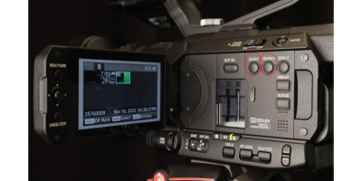
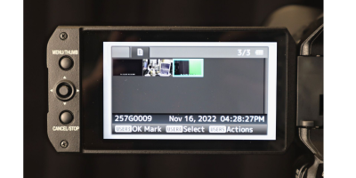
8
5.
(Optional) Managing/deleting videos using the camera
The gallery lets you delete videos and protect videos from deletion.
Fig. 5a. Lolux/3 and C.Review/4 buttons in controls area
1.
Mark videos for preservation or deletion using the Lolux/3 and C.Review/4 buttons (Fig. 5a), respectively:
1.i.
Press the Lolux/3 button to add/remove an “OK” indicator to/from a highlighted video. Videos with an “OK” indicator can’t be deleted using the gallery’s deletion functions.
1.ii.
Press the C.Review/4 button to add/remove a checkmark to/from a highlighted video. Videos with a checkmark are considered “selected.”
Fig. 5b. Gallery screen with button legend
Note: In the gallery’s legend (Fig. 5b), “User3” and “User4” correspond with the Lolux/3 button and C. Reviews/4 button, respectively

Slide 10
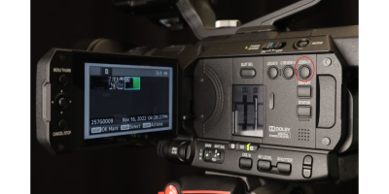
9
Fig. 5c. Zebra/5 button in controls area
2.
Press the Zebra/5 button (Fig. 5c) to open the sub-menu of actions.
3.
Use the directional button highlight and select “Delete Clips...” . A sub-menu appears with three options.
4.
In the “Delete Clips...” sub-menu, select a file set to delete:
4.a.
This Clip (the highlighted video),
4.b.
Selected Clips (all checkmarked videos), or
4.c.
All Clips (all clips not marked with “OK”).
5.
Use the directional button to highlight and select “Delete” to confirm deletion.
6.
Hold the Mode button to return to the recording/home screen.

Slide 11
10
6.
Transferring videos to a computer
1.
Turn off the camera using the On/Off switch:
1.1.
Push down the On/Off switch.
1.2.
While pushing this switch, slide it toward Off. The display will show a “P. Off” (power off) indicator for several seconds and then turn black. Also, the Power/Charge indicator will turn off.
2.
Remove the SD card (adapter) to which you recorded video:
2.1.
Press the exposed edge of the SD card inward. The spring inside the slot will extended the card further outward.
2.2.
Grab the SD card and pull it from its slot.
3.
Insert the SD card into the computer’s SD card slot (or and adapter connected to the computer).
4.
Open the virtual container (folder) that represents the SD card:
4.1.
Open either a File Explorer window (Windows/PC) or a Finder window (macOS/Mac).
4.2.
Open (click) the SD card’s container in the window sidebar (e.g., “MLC - JVC A” or “MLC - JVC B”).
5.
Open the “DCIM” sub-folder.
6.
Open the appropriate folder(s) inside the “DCIM” folder to locate your video(s).
7.
Copy your video(s) to your physical storage device(s) and/or cloud storage account(s).

Slide 12
11
7a.
Deleting videos by manual selection
1.
Delete any copies that you’ve saved to the MCL workstation computer.
2a.
(PC/Windows) Delete the original video(s) from the camera’s SD card:
a1.
In a File Explorer window, navigate to the applicable folder(s) inside the SD card’s “DCIM” folder.
a2.
Select your video(s).
a3.
Right-click on the video(s) and select the “Delete” command.
a4.
At the “Delete File” prompt, click “Yes.”
2b.
(Mac/macOS) Delete the original video(s) from the camera’s SD card:
b1.
In a Finder window, navigate to the applicable folder(s) inside the SD card’s “DCIM” folder.
b2.
Select your video(s).
b3.
Right-click on the video(s) and select the “Move to Trash” command.
7b.
Deleting videos by card formatting
Formatting/erasing the SD card can be more efficient if you have many videos, especially if they’re in multiple folders.
1a.
(PC/Windows) Use the Format command to completely erase the SD card:
a1.
In a File Explorer window, right-click on the SD card container in the sidebar. A command window opens.
a2.
Select the “Format...” command. A window appears with the title, “Format [SD card’s name].”
a3.
In the “File system” dropdown menu, select “exFAT (Default).” This format is compatible with Windows and macOS computers.
a4.
Click the “Start” button. A confirmation prompt appears.
a5.
Click the “OK” button.
1b.
(Mac/macOS) Use the Disk Utility app to completely erase the SD card:
b1.
Click the Spotlight search (icon of magnifying glass) in the top-right corner of the menu bar.
b2.
Type “Disk Utility” in the text field. Search results will appear below it.
b3.
Open the “Disk Utility” app from the search results.
b4.
In the app sidebar, select the SD card.
b5.
In the app toolbar, select the “Erase” command. A window will appear.
b6.
In the “Format” dropdown menu, select “ExFAT.” This format is compatible with Windows and macOS computers.
b7.
Click the “Erase” button. A window will show the progress.
b8.
Close the “Disk Utility” app.

Slide 13
12
2a.
(PC/Windows) Safely remove the SD card from the computer:
a1.
Open a File Explorer window and right-click on the SD card’s container in the window sidebar. A command window pops opens.
a2.
Select the “Eject” command. The SD card will disappear from the window sidebar.
a3.
Physically remove the SD card (or adapter) from the computer.
2b.
(Mac/macOS) Safely remove the SD card from the computer:
b1.
Open a Finder and right-click on the SD card’s container in the window sidebar. A command window pops opens.
b2.
Select the “Eject [SD card name]” command. The SD card will disappear from the window sidebar.
b3.
Physically remove the SD card (or adapter) from the computer.
8.
Restoring the camera to its original state
1.
Re-insert the SD card into the camera:
1.1.
Insert the SD card into its slot in the camera’s controls area.
1.2.
Press the exposed (top) edge of the SD card until that edge is flush with the slot opening.
2.
Push in/close the camera’s display panel.
3.
Re-attach the lens cap onto the lens:
3.1.
Pinch and hold the cap’s two side-releases.
3.2.
Press the cap into/against the housing of the lens.
3.3.
Release the cap’s side-releases.
4.
If the camera is detached from its tripod, place it on a desk and notify staff.

Slide 14
13
After using the device
1.
Return the camera to its original position in the studio, if applicable. Ask staff for help, if needed.

Slide 15
14
Attributions
Contributors
Media Creation Lab / York University Digital Scholarship Infrastructure
Maykel Faragalla, photographer
Tim Huynh, editor & contributing writer
Rafia Naz, lead writer
Shawon Saha, production assistant
BonaFide Communications, York University Writing Department
Nicole Bednarski, consultant
Charlotte MacDowell, consultant
Sophie Morgan, consultant
Amanda Naoum, consultant
Lorena Urican, consultant
Patrons of the Media Creation Lab
This work is licensed under a Creative Commons Attribution-NonCommercial 4.0 International License.

