Slide 1
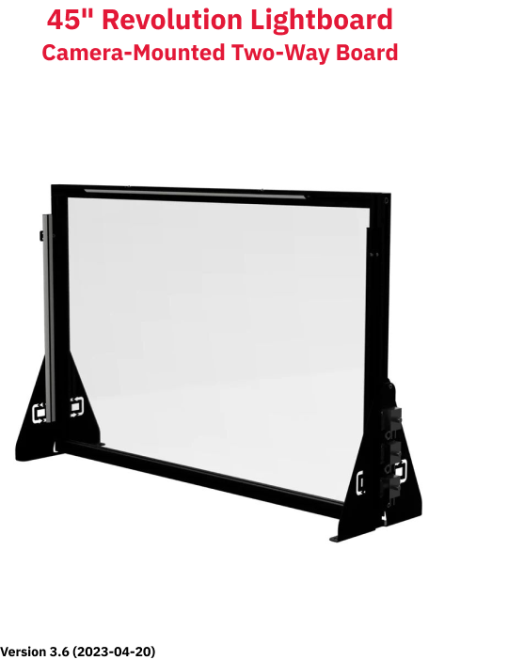

Slide 2
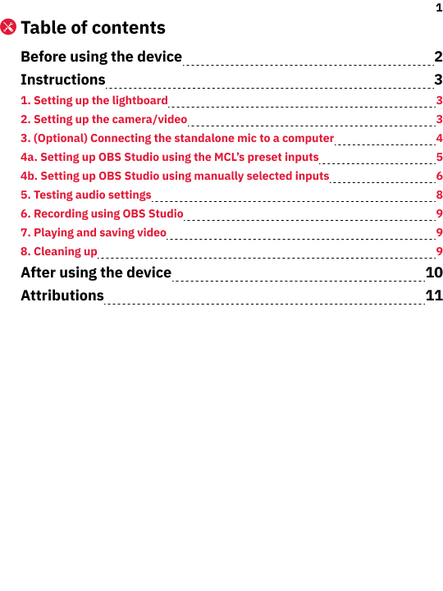

Slide 3
2
Before using the device
1.
Wear solid-color or simple-pattern tops. Additionally, wear darker colours to help the fluorescent ink stand out while directing attention to your face. In other words, busy patterns and/or bright colours will distract from the content.
2.
Avoid wearing clothes that have text or logos.
3.
Avoid writing directly in front of your face.
4.
Use the provided materials to write with and clean the board.
5.
Note that you need access to a computer that has both USB-A and USB-C ports.

Slide 4
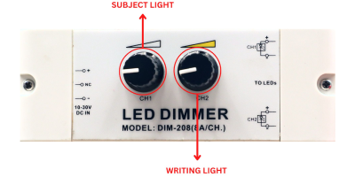
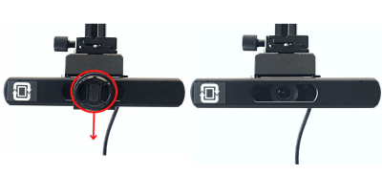
3
Instructions
1.
Setting up the lightboard
1.
Plug the lightboard’s power cable into the nearest outlet.
2.
Adjust the two brightness knobs located on the right side of the board (Fig. 1a) as needed:
2.1.
Turn the first knob (CH1) to adjust the brightness of the presenter.
2.2.
Turn the second knob (CH2) to adjust the brightness of the writing.
Fig. 1a. Brightness knobs on right side of board
2.
Setting up the camera/video
1.
Remove the camera lens’s filter-and-cap unit by sliding it downward and away from the bottom of the camera (Fig. 2a).
2.
Connect the USB cable from the socket on the back of the camera to the computer’s USB port (USB-A).
Fig. 2a. Removing filter-and-cap unit of camera lens

Slide 5
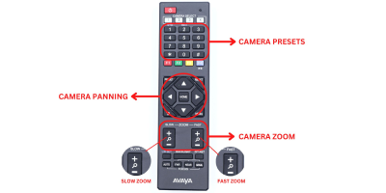
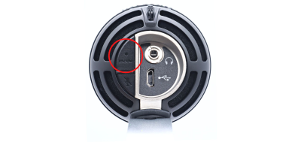
4
3.
(Optional) Become familiar with the remote control (Fig. 2a):
3.i.
Pan/move the camera using the arrow buttons (middle of remote).
3.ii.
Zoom in/out using the two pairs of + and - buttons (bottom third).
3.iii.
Navigate the presets using the number buttons (top of remote).
Fig. 2a. Remote control
3.
(Optional) Connecting the standalone mic to a computer
The lightboard unit has a standalone mic (Shure M5VC) as well as a camera mic (Avaya HC020).
1.
(Optional) Connect the standalone mic to the computer using the USB-A to USB-C cable. Its power light (middle indicator, below Shure label) will light.
2.
(Optional) Connect headphones to the back/bottom of the mic (Fig. 3a).
2.
(Optional) Press and hold the Mode button to enable listening while recording. The headphone light (left indicator) will turn green.
Fig. 3a. Mode button on bottom/back of Shure M5VC mic

Slide 6
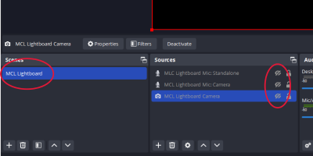
5
4a.
Setting up OBS Studio using the MCL’s preset inputs
Follow the steps in this section to use preset input-sources on the MCL computer.
1.
Ensure that the lightboard’s camera and, if desired, the standalone mic are connected to the workstation computer by USB cables.
2.
Open the OBS Studio on the computer.
3.
In the Scenes panel (lower left of interface), select the MCL Lightboard scene (Fig. 4a). This configuration includes the lightboard’s camera, its mic, and the provided standalone mic as input sources.
4.
In the Sources panel, enable the MCL Lightboard Camera source by clicking its visibility toggle (eye icon, Fig 4a). Footage from the camera will appear.
Note: If footage doesn’t appear, close and re-open OBS Studio.
5.
In the Sources panel, enable either the camera’s mic or the standalone mic:
a.
To use the camera’s mic, enable the visibility for the MCL Lightboard Mic: Camera source (Fig. 4a).
b.
To use the standalone mic, enable the visibility for the MCL Lightboard Mic: Standalone source (Fig. 4a).
Note: If the chosen mic’s volume meter (in the Audio Mixer panel) is inactive, close and re-open OBS Studio.
Fig. 4a. Scenes panel and Sources panels with presets

Slide 7
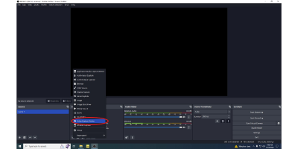
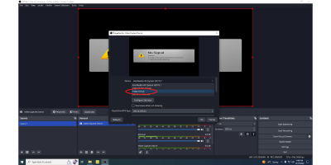
6
4b.
Setting up OBS Studio using manually selected inputs
Follow the steps in this section to manually select input-sources on your computer or (if the steps section 4a don’t work) on the MCL computer.
1.
Open the OBS Studio on the computer.
2.
Add and select the lightboard’s camera as a video source:
2.1.
Create a new scene by clicking the plus sign (+) located in the Scenes panel (lower left of interface). OBS Studio requires at least one scene.
2.2.
Add a video capture device by clicking the plus sign located in the Sources panel and selecting Video Capture Device (Fig. 4b).
2.3.
(Optional) Rename the video-capture device to reuse it in the future.
2.4.
Click the Devices dropdown menu and select the input device titled Avaya HC020 (Fig. 4c). Video should appear in the preview pane.
Fig. 4b. Adding video-capture device in OBS Studio
Fig. 4c. Changing input device to lightboard’s Avaya camera

Slide 8
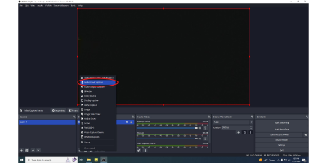
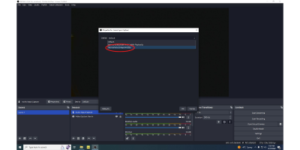
7
3.
Add and select a mic as an audio source:
3.1.
Add an audio capture device by clicking the plus sign located in the Sources panel and selecting Audio Input Capture (Fig. 4d).
3.2.
(Optional) Rename the audio capture device for easier reference.
3.3.
Click the Devices drop-down menu and locate the input device that you want to use:
a.
To use the lightboard camera’s mic, select Microphone (Avaya HC020) (Fig. 4e).
b.
To use the standalone mic that’s provided, select Microphone (Shure M5VC (With Playback)).
c.
To use still a different mic, select it from the list.
Fig. 4d. Adding audio-capture device in OBS Studio
Fig. 4e. Changing input device to Avaya microphone

Slide 9
8
5.
Testing audio settings
Do a test recording to ensure proper audio settings.
1.
Speak normally and continuously. Consider reciting the alphabet.
2.
In the Audio Mixer panel, watch the volume meter of the chosen mic. In general, the volume level should peak between the -25 and -15 (decibels) marks. The ideal peak level is -12 decibels.
3.
(Optional) Adjust the mic volume in OBS Studio:
3.1.
In the lower-left corner of the Audio Mixer panel, click the gear icon. The Advanced Audio Properties window will open.
3.2.
Increase or decrease the dB value for the chosen mic in the Volume column as needed.
3.3.
Close the Advanced Audio Properties window.
4.
Mute all audio-inputs other than the chosen mic:
4.1.
Locate the volume meter of any other audio-input.
4.2.
Click the speaker icon below that volume meter. The speaker icon will turn red and have an ‘x’ beside it. The volume meter will also dim and turn grey.
4.3.
Repeat steps 4.1 and 4.2 for all audio-inputs other than the chosen one.

Slide 10
9
6.
Recording using OBS Studio
1.
Start recording by pressing the Start Recording button in the Controls panel. The button label will change to Stop Recording and the bottom of the window will show elapsed recording time.
2.
Speak and write on the lightboard for an appropriate amount of time.
3.
Stop recording by pressing the Stop Recording button. Its label changes to Stopping Recording ... while the software saves the video file.
4.
Wait for the video file to save: the Stopping Recording ... button will change its label back to Start Recording.
7.
Playing and saving video
1.
Ensure that computer’s audio output plays from its built-in speakers:
1.1.
Click the Windows icon in the taskbar (lower-left corner of screen) to open the Start menu.
1.2.
Select Settings to open the Windows Settings window.
1.3.
Select System -> Sound to open the Sound panel.
1.4.
In the Output section, set the output device to Speaker (Realtek(R) Audio) or Headphones (Realtek(R) Audio).
2.
Locate the video on the computer’s Desktop, which is the default save-location.
3.
Play the recorded video.
4.
Copy your video file(s) to cloud storage and/or removable physical storage.
8.
Cleaning up
1.
Use the provided cloths to erase your markings from the lightboard.
2.
Use the provided squeegee to ensure the board is completely clear and ready for the next patron.

Slide 11
10
After using the device
1.
Return the camera to its original position in the studio, if applicable. Ask staff for help, if needed.

Slide 12
11
Attributions
1.
Contributors
Media Creation Lab / York University Digital Scholarship Infrastructure
Maykel Faragalla, lead writer & photographer
Tim Huynh, editor, & co-lead writer
Rafia Naz, contributing writer
Shawon Saha, production assistant
BonaFide Communications, York University Writing Department
Nicole Bednarski, consultant
Charlotte MacDowell, consultant
Sophie Morgan, consultant
Amanda Naoum, consultant
Lorena Urican, consultant
Patrons of the Media Creation Lab
This work is licensed under a Creative Commons Attribution-NonCommercial 4.0 International License.

