Slide 1
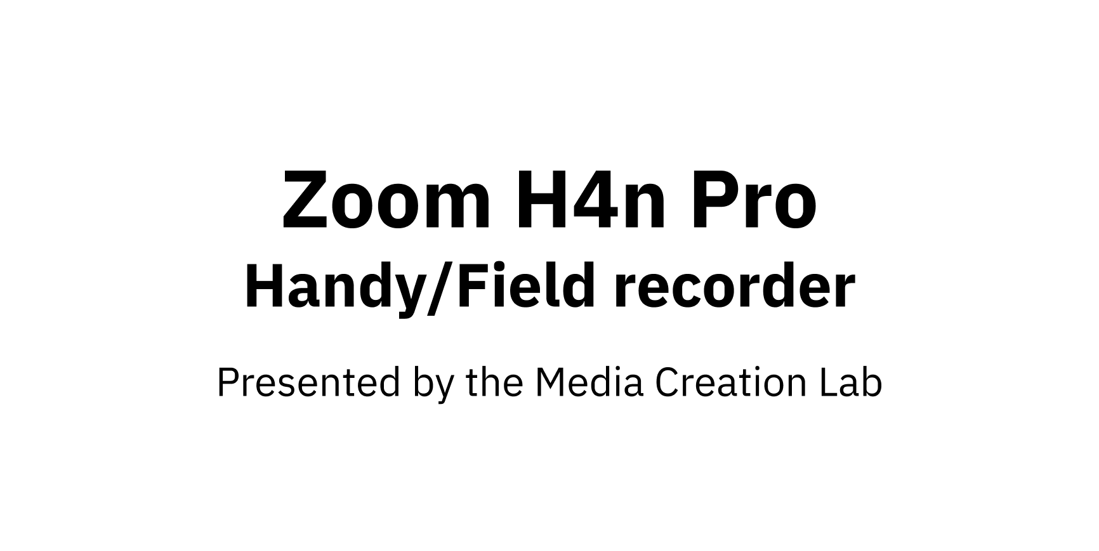
1

Slide 2
MCL
2
Contents
1.
Overview & Power
3
2.
Input
10
3.
Output
17
4.
Recording & Playback
25
5.
Usage with Computer
29
References
33

Slide 3
MCL
3
1. Overview & Power

Slide 4
MCL
4
1.1. Overview
Handy/field recorder
Serious musicians: Live/studio performances
Interviews, podcasts
Standalone microphone / audio interface
Buttons including Menu button & scroll dial
Press Menu to open main menu, cancel/return
Scroll dial to highlight, press to select

Slide 5
MCL
5
1.2. Turning On/Off
Power button on left side
Slide to I/O icon & hold for 2 sec
Startup / shutdown time: ~2 min
Correlation(?) to storage capacity of SD/SDHC card
Compatible cards: 512 MB - 32 GB
(Zoom, 2016)

Slide 6
MCL
6
1.3. Power Options
AC adapter (bottom): Plug to power socket
Batteries (back side): Two AA batteries
Bus power (left side): USB cable to computer

Slide 7
MCL
7
1.3.a. Power Options: AC adapter
Port on bottom
5 volts, 1 amps

Slide 8
MCL
8
1.3.b. Power Options: AA Batteries
Housing component on back
Alkaline or nickel-metal hydride (Ni-MH, 2500 mAh)
Menu -> System -> Battery -> [Alkaline/Ni-MH]
Stamina mode: Longer battery life vs limited functions
Open cover & slide Stamina button to On
Battery life: Recommend duration is ~3-4 hrs
Alkaline: ~5.5 hrs (~8 hrs in Stamina mode)
Ni-MH: ~7.5 hrs (~10 hrs in Stamina mode)
(Zoom, n.d.)

Slide 9
MCL
9
1.3.c. Power Options: Bus Power
Mini-USB port on left side
Connect cable to computer with USB-A port/adapter
H4n can be turned off
While turned on, select Menu -> USB -> [mode]
Storage: Transfer files to computer
Audio I/F (interface): Use device only as mic

Slide 10
MCL
10
2. Input

Slide 11
MCL
11
2.1. Core Concepts
Channel: Representation of sound to/from any point
Mono: One channel, file has combined L/R section
Stereo: Two channels, file has separate L/R sections
H4n Pro mode selection: Menu -> Mode -> [mode]
Stereo: Record two channels
4CH: Record four channels
MTR: Play/record multiple tracks at same time

Slide 12
MCL
12
2.2. Input Options
Built-in mics (top)
External 3.5 mm mic (back side)
External 1/4 in and/or XLR mics (bottom)
In Input section of front, press Mic, 1, or 2 button
4CH mode automatically selects Mic, 1, & 2

Slide 13
MCL
13
2.2.a. Input Options: Built-in Mics
Twin mics on top in X/Y configuration
90- or 120-degree pickup pattern (recording area)
Twist both mic knobs to 90 or 120 label
90: One audio source (e.g. person)
Place parallel to floor & point to source
120: Two+ audio sources (e.g. two persons)
Place perpendicular to floor & between sources

Slide 14
MCL
14
2.2.b. Input Options: 3.5 mm Mic
3.5 mm port on back
Uses cases:
Condenser/desktop mics
Lapel/lavalier mics
Receiver of wireless mic system
Automatic override of built-in mics

Slide 15
MCL
15
2.2.c. Input Options: 1/4-in, XLR mics
Two combo ports (1/4 in or XLR) on bottom
Press Push lever to release
Use cases:
Mics, instruments (guitars, keyboards)
Receiver of wireless mic system
Inputs 1 & 2 share volume by default
Menu -> Input -> 1/2 Link -> [On/Off]
Inputs 1 & 2 each record one channel
One-sided stereo recording

Slide 16
MCL
16
2.3. Recording Level (Volume)
Rec Level buttons (right side): Change [Input] Level
Press Input button on front to match input
Resting, standby (ideal), or recording state
Preview mic level before recording:
Press Rec button to enter standby
Position device/mic as intended
Produce sound as intended & observe on-screen meters
Adjust [Input] Level so peaks are at -12 dB mark (+/- 3)

Slide 17
MCL
17
3. Output

Slide 18
MCL
18
3.1. Output Options
Built-in speaker (back side)
Headphone/line-out (left side)

Slide 19
MCL
19
3.1.a. Output Options: Built-in Speaker
Built-in speaker on back side
Standalone or audio-interface mode

Slide 20
MCL
20
3.1.b. Output Options: Headphone/Line
3.5 mm port on left side
Use cases:
Headphones
External speakers (amplification)
Sound board/mixer

Slide 21
MCL
21
3.2. Output Volume
Vol buttons on left side: Change (output) Volume
Resting, standby, recording, or playback states
Independent of Rec Level

Slide 22
MCL
22
3.3. File Formats
WAV or MP3
WAV: Higher quality
Create recording marks (bookmarks for playback)
MP3: Smaller file-size
Format selection
Menu - > Rec -> Rec Format -> [format]
(Main screen) Press WAV/MP3 button -> [format]

Slide 23
MCL
23
3.4. File Organization
Recording modes have separate folders & sub-folders
Stereo -> [Folder01 ... Folder10] -> [file]
4CH -> [Folder01 ... Folder10] -> [files]
4CH recordings: Twin files appended with I or M
MTR -> ProjXYZ -> [file]

Slide 24
MCL
24
3.5. Folder/File Selection
Select sub-folder (within current mode folder)
Menu -> Folder
(Main screen) Press Folder button
Select file in current sub-folder
Menu -> File
(Main screen) Press File button

Slide 25
MCL
25
4. Recording & Playback

Slide 26
MCL
26
4.1. Accessories
Tripod with 1/4 in screw
Fur windshield

Slide 27
MCL
27
4.2. Rec Button
Enter standby state
Preview recording level
Start recording from standby state
(Alternative) Press Play button
(Optional) Set marks while recording (WAV only)
Press before relevant points
Can have 99 marks
Note button doesn’t function as pause button

Slide 28
MCL
28
4.3. Other Buttons
Stop button: Stop recording; stop playback
Play/Pause button:
Recording: Start (from standby), pause/resume
Playback: Play/pause/resume playback
Skip buttons: Skip to next/previous file
(If applicable) Skip to next/previous mark within file
Key Hold (left side): Disables button input
Slide power switch to Hold

Slide 29
MCL
29
5. Usage with Computer

Slide 30
MCL
30
5.1. File Transfer
Transfer by USB cable
Insert USB cable into mini-USB port on left side
Connect cable to computer & turn off H4n
(H4n) Select Storage & (computer) locate H4N_SD drive
Transfer by SD card
Remove SD card from covered slot on right side
Insert into computer with slot/adapter
(Computer) Locate H4N_SD drive

Slide 31
MCL
31
5.2. USB Mic
Setup on H4n
(Recommended) Turn off H4n
Connect USB cable (Micro-USB port, left side)
Connect cable to computer
Select Audio I/F
Select Frequency -> 48kHz (44.1kHz possible on Mac)
Select Connect
H4n appears on computer as H4

Slide 32
MCL
32
(continued)
Setup on Mac (macOS)
Open Applications -> Utilities -> Audio MIDI Setup
Or use Spotlight Search to find Audio MIDI Setup
Select H4 (2 ins / 0 outs) in sidebar
Set Format drop-down to equivalent frequency on H4n
(H4n) 44.1kHZ = (Mac) 44,100 Hz
(H4n) 48kHZ = (Mac) 48,000 Hz
Discrepancies: higher/lower pitch of recordings

Slide 33
MCL
33
References

Slide 34
MCL
34
Zoom. (n.d.). Zoom H4n Pro Black. https://zoomcorp.com/en/ca/handheld-recorders/handheld-recorders/h4n-pro/
Zoom. (2016). H4n/H4nPro operation confirmed SD/SDHC cards. https://zoomcorp.com/media/documents/H4n_H4nPro_compatible_cards_en_2.pdf

Slide 35
MCL
35
Content by Tim Huynh
This work is licensed under a
Creative Commons Attribution-NonCommercial 4.0 International License.

